Slide 1


Advanced Skin Disease Diagnosis leveraging image processing
- By Team 9

Slide 2

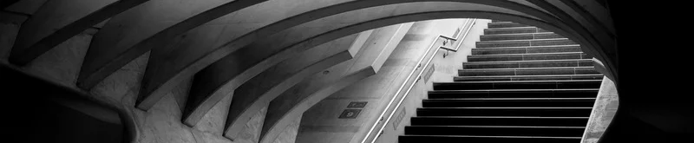

Agenda
Introduction | 3
Project Overview | 4
Mile Stones | 7
Screen shots | 14
Conclusion | 15
Our Team | 16

Slide 3
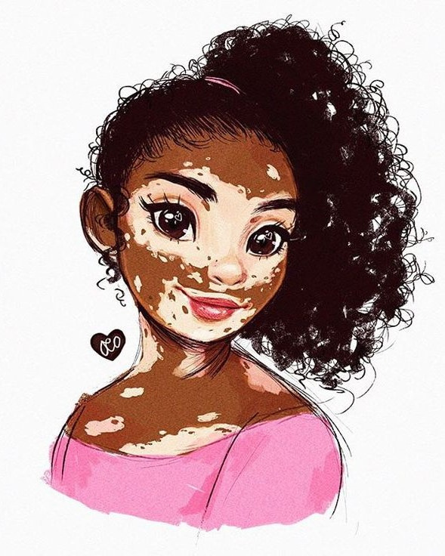
Introduction
Skin diseases affect millions, yet traditional diagnosis methods are costly and limited. OpenCV offers a solution by analyzing skin images for features like color, texture, and shape to identify abnormalities linked to conditions like eczema or melanoma. This approach is faster, cost-effective, and more accessible, especially in underserved areas, with the potential for enhanced accuracy when combined with machine learning.

Slide 4
HOME PAGE: In this page we have two buttons those are login and signup.
LOGIN PAGE: If you have an account in this site you need to enter the username and password for redirecting into the profile page.
SIGNUP PAGE: If you are new user you need to create the account using this button. In this we need to enter username and password and confirm password.
After creating the account you will redirected to profile page
PROFILE PAGE: In this we need to upload the picture for skin disease identification.
Project Overview
Customer Feature

Slide 5

GOAL # 1
We created three pages home page, login page, signup page and profile page.
We established the data base connectivity also.
After successful registration or login we will redirected to profile page.
MILE STONES
GOAL # 2
We learned about the installation and image processing techniques using opencv.
We practiced and generated some images using the opencv.

Slide 6
GOAL # 3
We created an image upload functionality where users can upload images through the profile page.
We implemented file handling using `FileSystemStorage` to save the uploaded images.
After uploading, the image URL is dynamically generated and passed to the profile page for display.
We used opencv for performing normalization, finding dimensions
MILE STONES

Slide 7
GOAL # 4
In Milestone 4, we trained the DINO (Distillation with No Labels) model using a Vision Transformer (ViT) architecture for skin disease classification.
We use the DINO model due to its self-supervised learning capabilities, robust ViT architecture, and effective use of diverse datasets, which make it a cutting-edge solution for skin disease classification. It delivers exceptional accuracy and strong generalization across varied conditions, meeting the project's requirements for reliability and adaptability.
The model, trained on our dataset and tested with test dataset, achieved approximately 92% accuracy in predicting skin diseases from uploaded images.
The trained model was then integrated into our project for real-world application by dumping and reloading it into the system.
MILE STONES

Slide 8

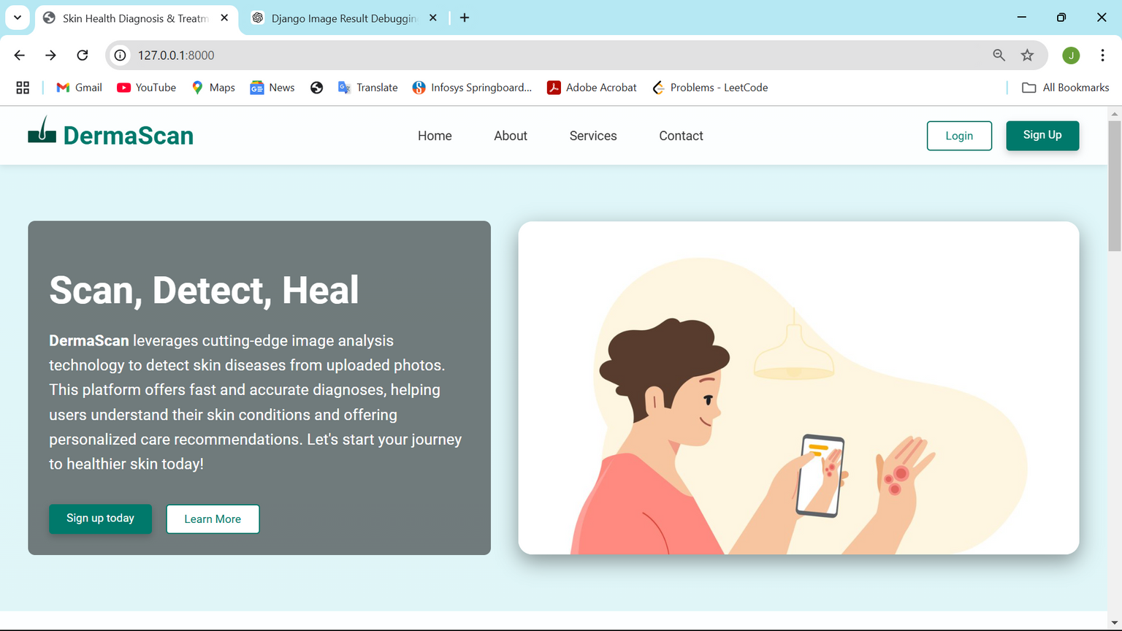
HOME PAGE

Slide 9

SIGN UP PAGE

Slide 10
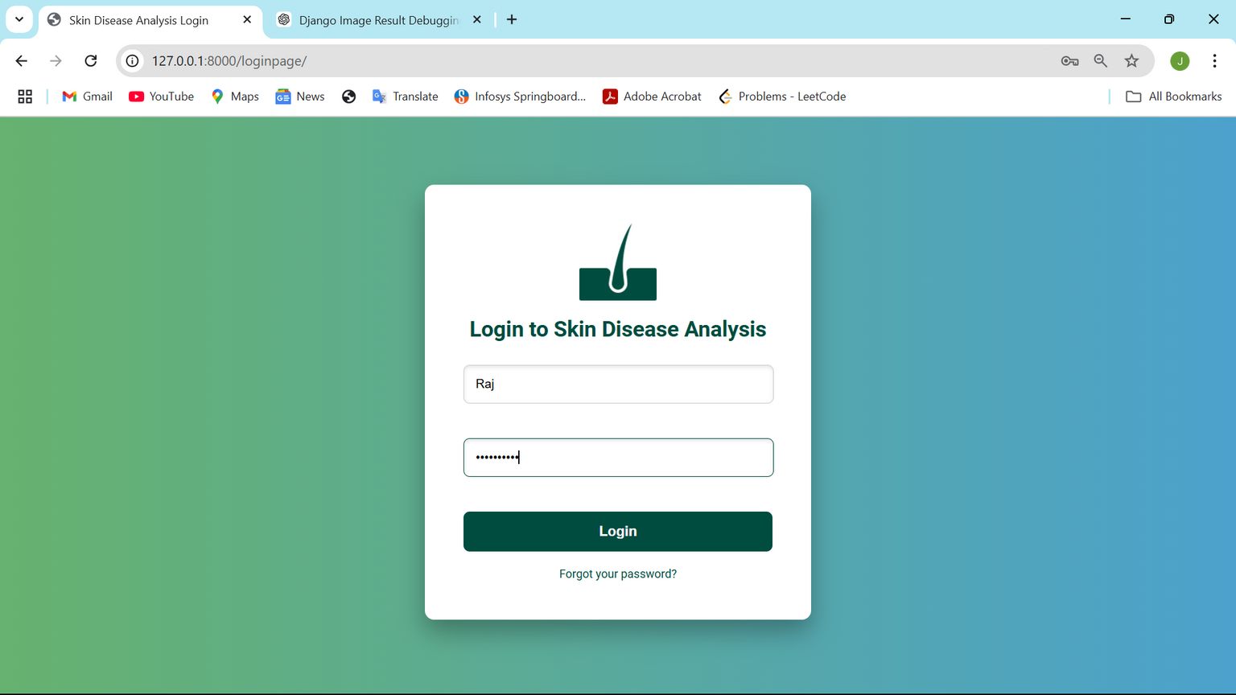
LOGIN PAGE

Slide 11
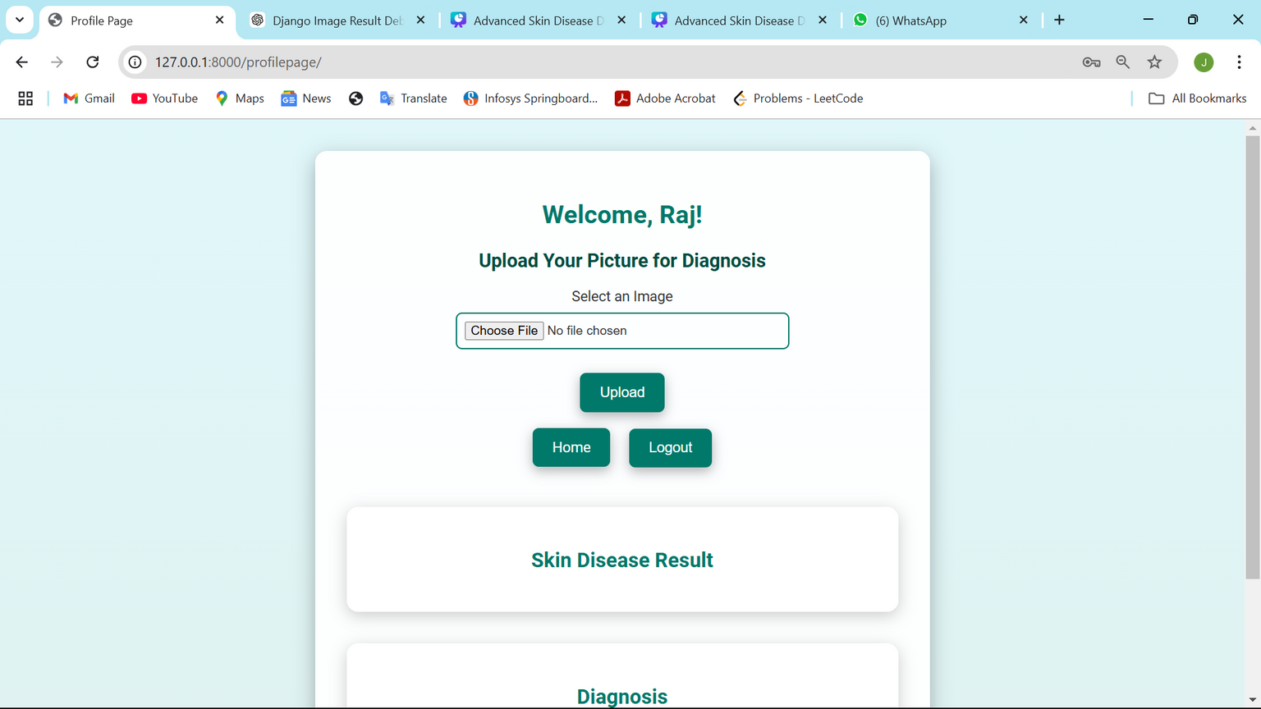
PROFILE PAGE

Slide 12
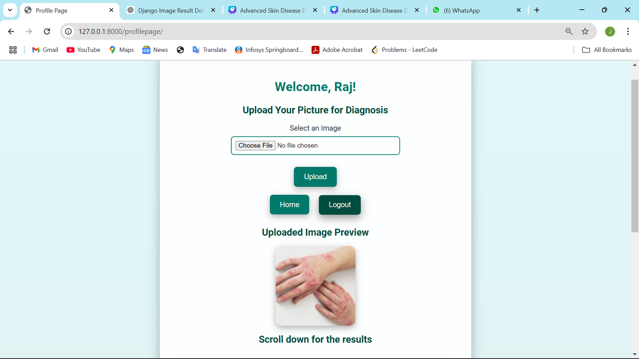
IMAGE PREVIEW

Slide 13
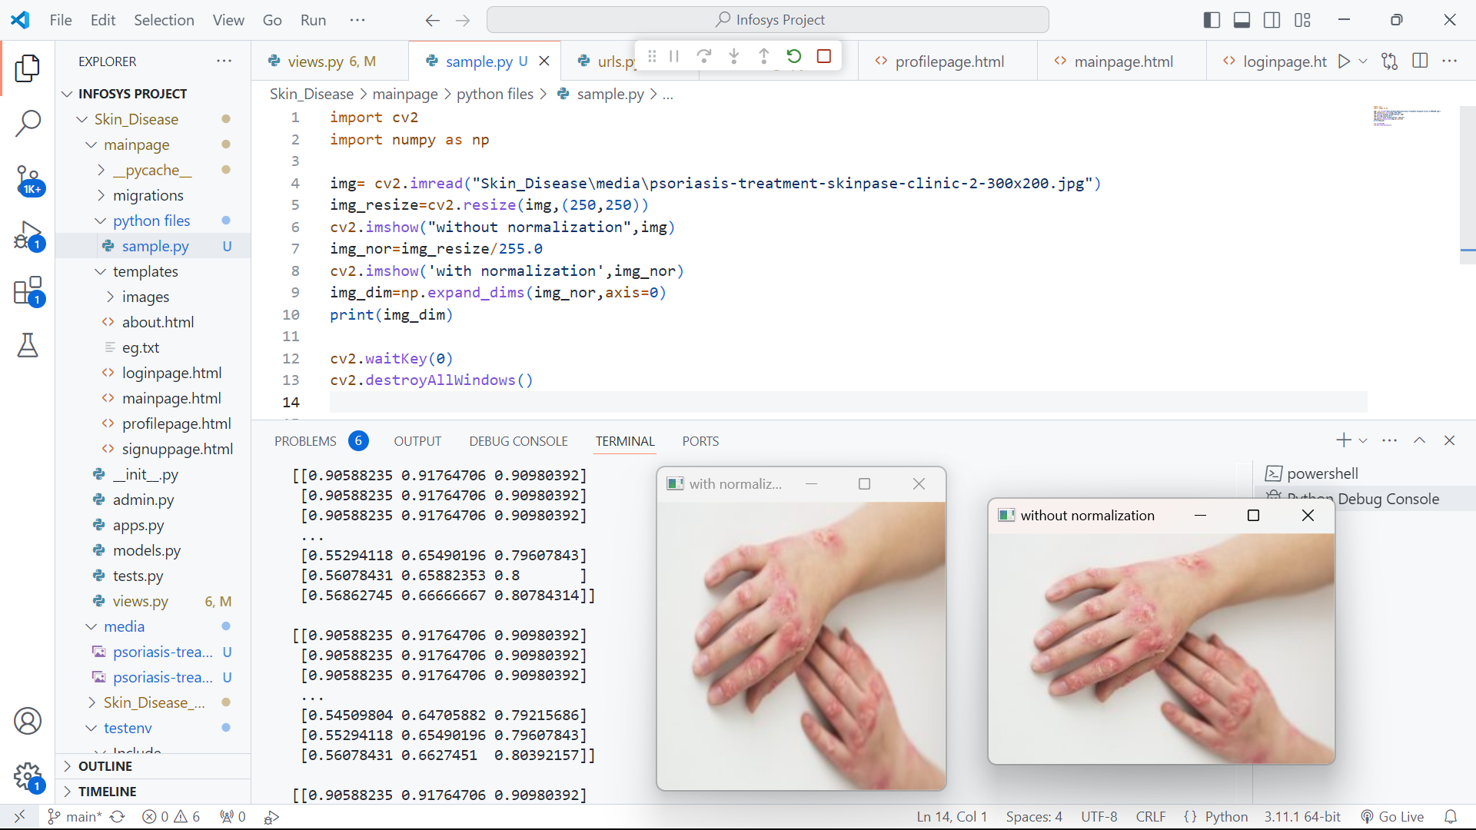
UPLOADED IMAGES
DIMENSIONS

Slide 14
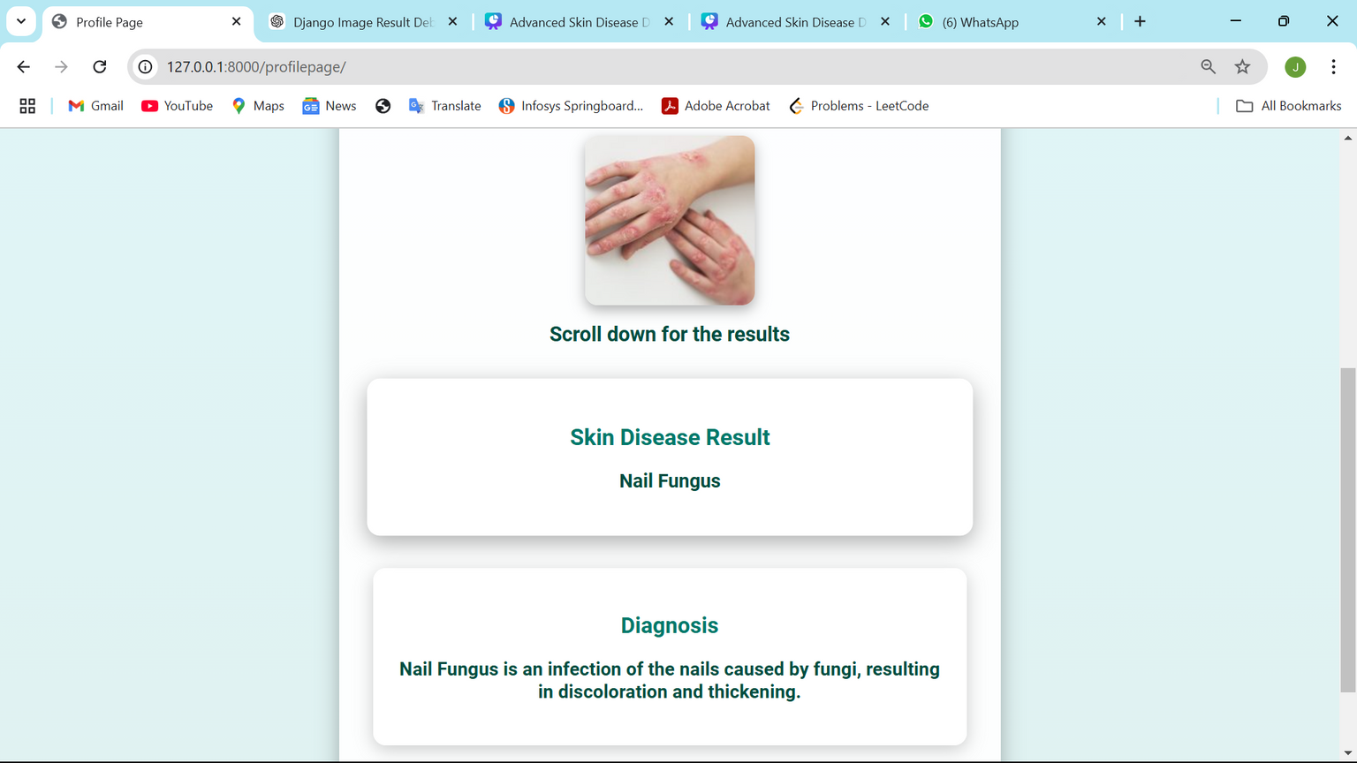
RESULT

Slide 15
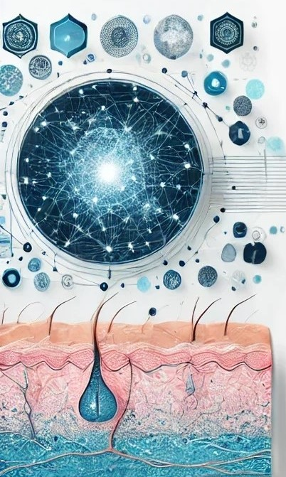
We developed a multi-page web application with login, signup, and profile functionalities, ensuring seamless navigation and secure database connectivity.
In Milestone 2, We gained expertise in image processing techniques using OpenCV, enabling advanced operations like normalization and dimension extraction
We implemented an image upload and storage system, allowing users to upload images, process them, and display results dynamically on the profile page..
We implemented file handling using `FileSystemStorage` to save the uploaded images.
After uploading, the image URL is dynamically generated and passed to the profile page for display.
We trained and integrated the cutting-edge DINO model with a Vision Transformer (ViT) architecture, achieving 92% accuracy in skin disease classification, demonstrating real-world applicability.
CONCLUSION

Slide 16

TEAM 9
Rajesh Jinagam
Team Leader
MEET OUR TEAM
Rashwanth Rajesh
Team member 1
Prudhvi Koppada
Team member 2

Slide 17
THANK YOU
- Team 9

